Slide 1
Chapter 10 Prototype/Test Cycles
Clark & Wheelwright – Managing New Product and Process Development
Francisco Matelli Matulovic

Slide 2
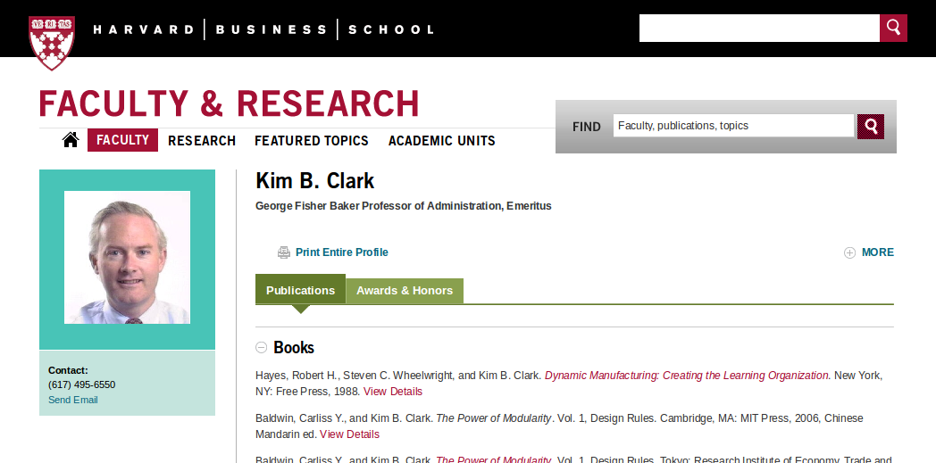
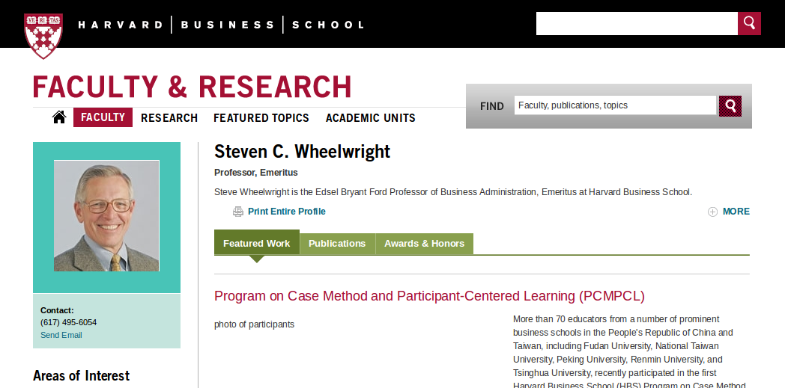

Slide 3
Chapter 10 Prototype/Test Cycles
Overview
The Traditional Approach to Prototyping
Prototyping: A Managerial Perspective
Matching Prototyping and Development Project Requirements
Study Questions
Cases: Sony Corporation: Workstation Division

Slide 4
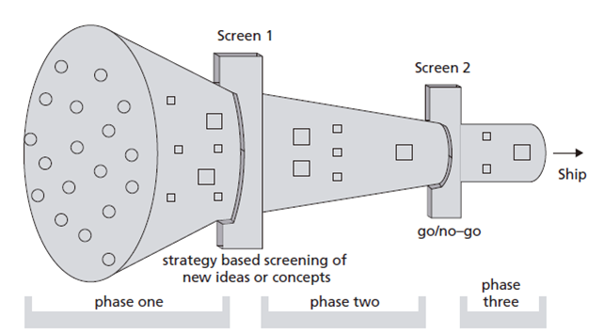

Slide 5
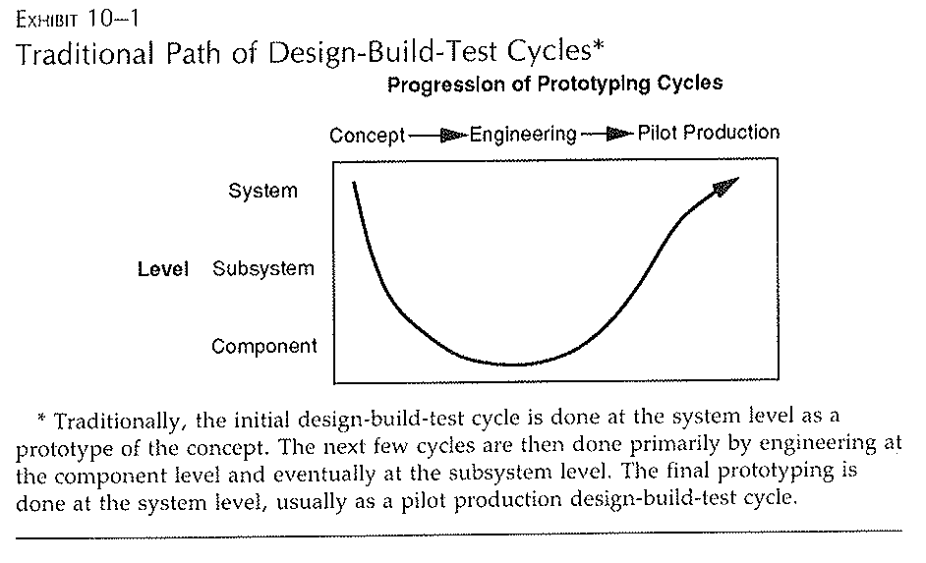

Slide 6
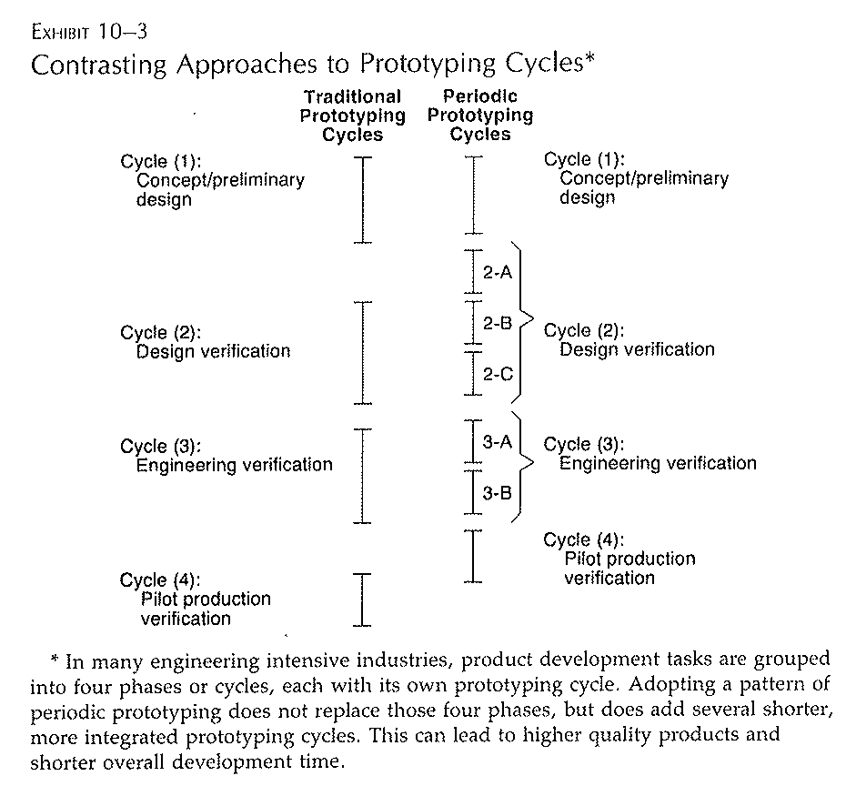

Slide 7
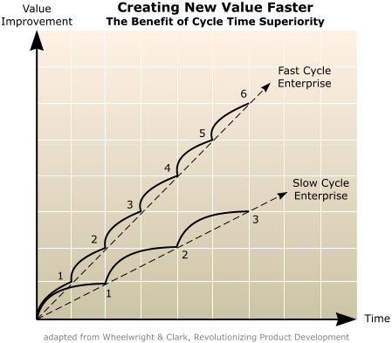

Slide 8
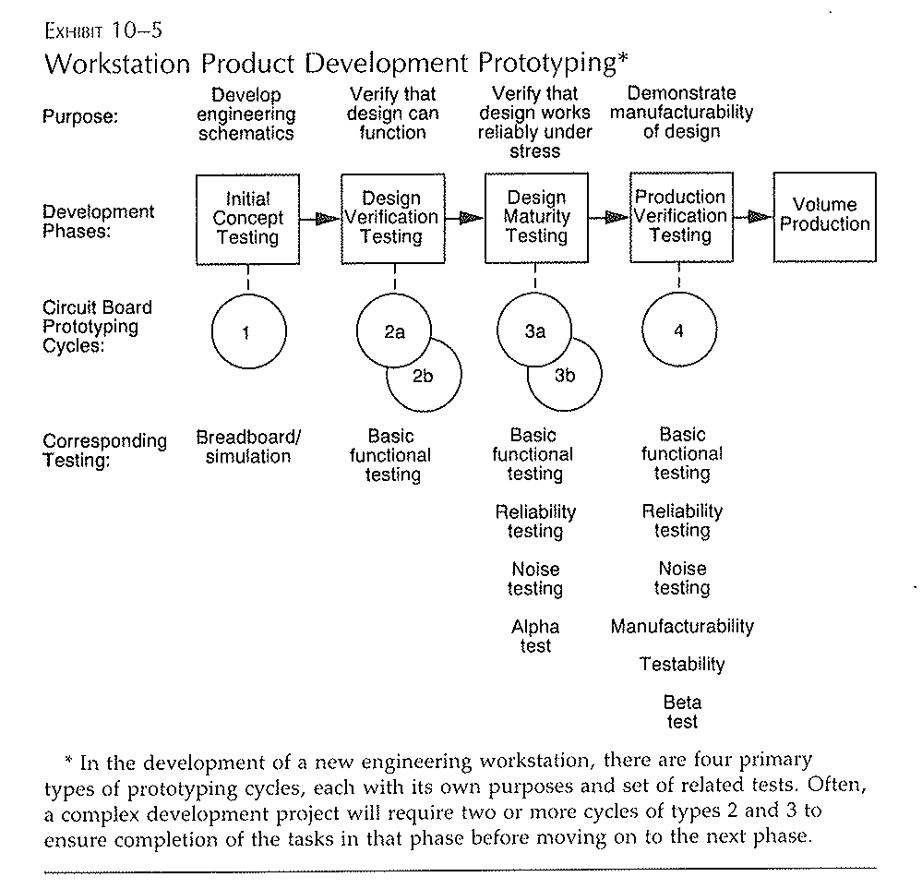

Slide 9
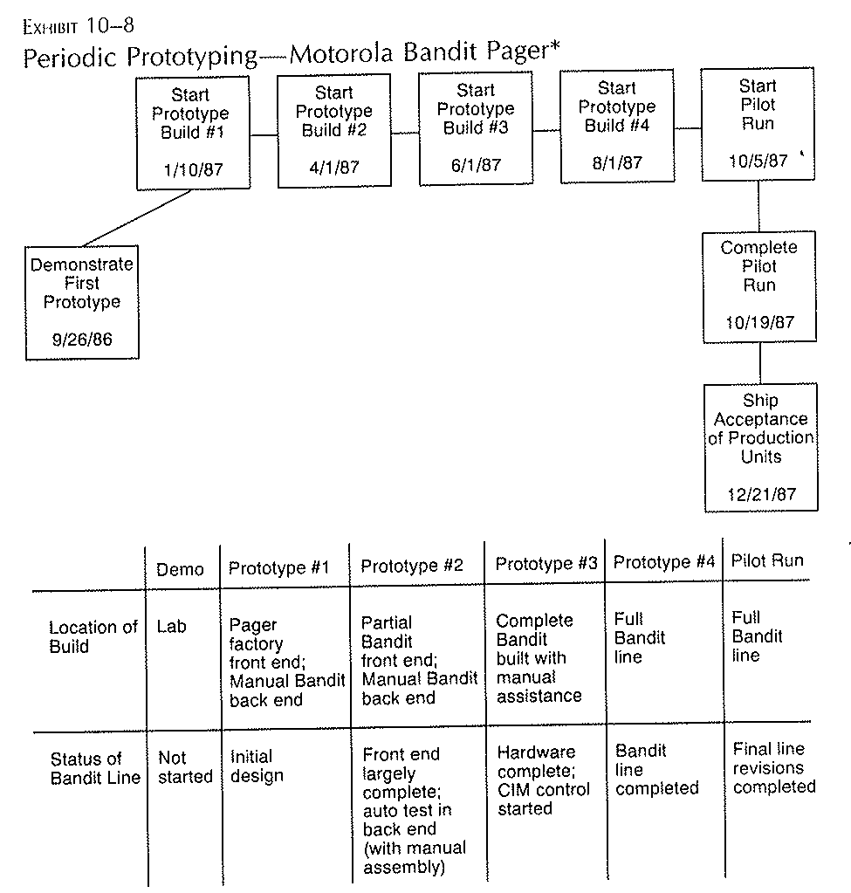

Slide 10
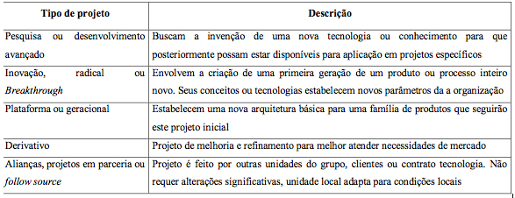

Slide 11
Core argument
An improvement to innovative process can lead companies to achieve goals and dominate markets.

Slide 12
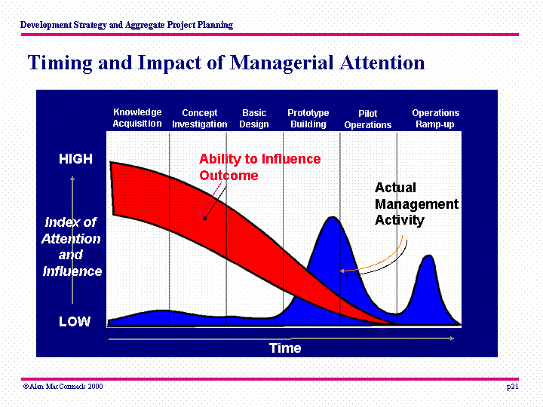

Slide 13
Recommendations
Managers participation Like (Kim and Willemon, 2002) the authors attempt to the fact that managers should be more present in every step of the process, not just only at the end evaluating the final prototype.

Slide 14
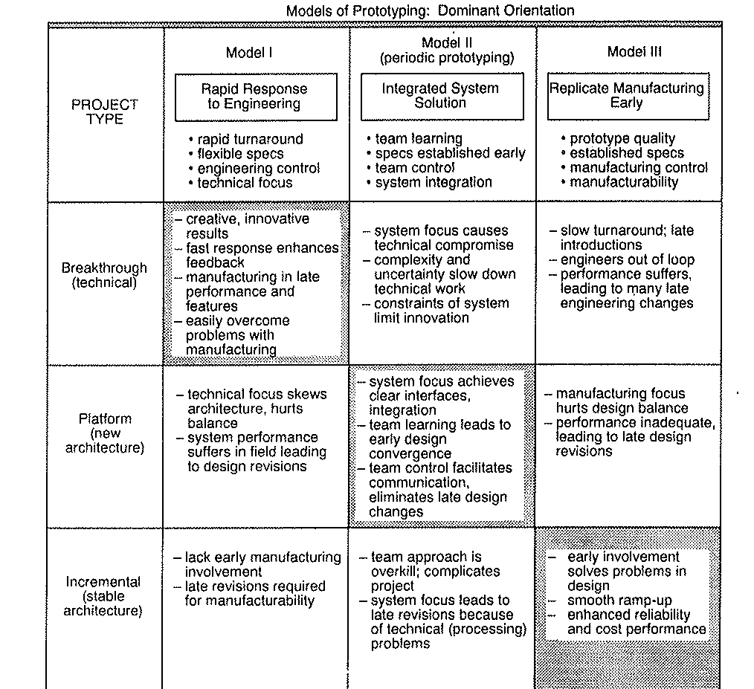

Slide 15
O que é o ciclo de Design-Build-Test em prototipagem?
O que a abordagem convencional?
Problemas com a aboradgem convencional?
O que é a abordagem periodica de prototipagem?
Como selecionar diferentes abordagens de prototipagem? Por que a Periodica não é adequada para Avião de garnde porte?

